Slide 1

OPERATING SYSTEMS Module 2 :Process Management & CPU Scheduling Date & Time:
Dr. Rita Roy
Assistant Professor
Department of Computer Science
GITAM Institute of Technology (GIT)
Visakhapatnam – 530045
Email: rroy2@gitam.edu
Mobile- 9493004089

Slide 2

COURSE OBJECTIVES
● To introduce students with basic concepts of operating system, its functions and services.
● To provide the basic concepts of process management and synchronization.
● To familiarize the dead lock issues.
● To understand the various memory management schemes.
● To give exposure over I/O systems and mass storage structures and Linux system.

Slide 3
UNIT - II LTP 8 0 6
Process Management: Process concepts, process scheduling, Operations on processes, interprocess communication
CPU Scheduling: Multithreaded programming, Multi-core Programming, Multi-threading Models,
Scheduling-criteria, scheduling algorithms, algorithm evaluation.
Learning Outcomes:
After completion of this unit, the student will be able to
• demonstrate the concepts of Process, thread and CPU scheduling L2
• list out different scheduling algorithms L1
• analyze scheduling algorithms with different examples L4
Pedagogy tools: Blended learning, Case let, video lectures, self-reading

Slide 4
MODULE- 2
PART -1 Process Management
Process Concepts
The Process
Process States
Process Control Block(PCB)
Process Scheduling
Scheduling Queues
Schedulers
Context Switch
Operations on Processes
Process Creation
Process Termination
Inter process Communication
Shared Memory systems
Message Passing Systems
PART -2 - CPU Scheduling
Thread Scheduling
Threads –
Threads Vs Process
Thread Scheduling – T
Multithreading Models
Multiple Processor Scheduling
Multi core Programming
CPU Scheduling
Scheduling Criteria
Types of Scheduling MODES – Preemptive and Non-Preemptive
Types of Scheduling –GANTT CHART
Scheduling Algorithms
Algorithm Evaluation

Slide 5
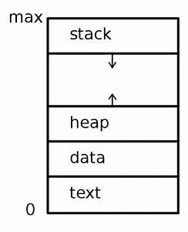
Process Concepts:
Process: A Process is a program in execution. Process is not as same as program code but a lot more than it. Attributes held by process include hardware, memory, CPU etc.
Process Memory is divided into 4 sections for efficient working:
Process in Memory
1) Text Section: It includes the current activity, as represented by the value of the program counter and the contents of the processor registers.
A Process includes Process Stack, which contains temporary
data(such as function parameters, return addresses and Local
variables.
2) Data Section: It contains global and static variables
3) Heap: It is used for the dynamic Memory Allocation and is managed
via calls to new, delete, malloc , free etc
4) The Stack: It is used for local variables. Space on the stack is reserved for
local variables when they are declared.

Slide 6
A Program is a Passive Entity – It contains a File containing a list of
Instructions stored on Disk(called an Executable File) .
A Process is an Active Entity – It contains a Program Counter and it specifies the next instruction to execute and set of associated resources.
Note:
A Program becomes a process when an executable File is loaded into memory. Two common techniques for loading executable files are
Double clicking an icon
Entering the Name of the Executable file on the command line(as in prog.exe or \a.out)
A system maintains lib files, exe files, bin files –system calls
A Process –a program executes in the mm(Executable files) – Program is a Passive entity
A process comes under active entity

Slide 7
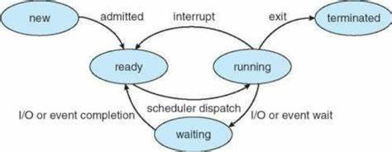
Process State:
New: The Process is being created.
Ready:- The Process is waiting to be assigned to a processor.
Running: Instructions are being executed.
Waiting:- The Process is waiting for some event to occur(such as an I/O completion or reception of a signal)
Terminated:- The Process has finished execution

Slide 8
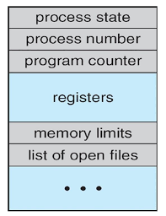
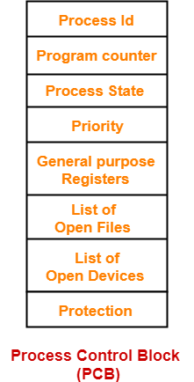
Process Control Block(PCB) or Task Control Block(TCB)

Slide 9
Process State: The state may be new, ready, running, waiting, halted Eg: Process ID and Parent Process ID
Program Counter: The counter indicates the address of the next instruction to be executed for this process.
CPU Registers: The registers vary in number and type, depending on computer architecture. They include accumulators, index registers, stack pointers.
CPU Scheduling Information:- This information includes a process priority ,pointers to scheduling Queues, any other scheduling queues, any other scheduling parameters.
Memory Management:- This information may include such items as the value of the base and limit registers and the page tables or segment tables, depending on the memory system used by the Operating System.
Accounting Information: This information includes the amount of CPU and Real Time, Time Limits, Process ID.
I/O Status Information:- This information includes the list of I/O devices allocated to the process, a list of open files.

Slide 10
Process Scheduling: The act of determining which process in the ready state should be moved to the running state is known as Process Scheduling
The Prime aim of the process scheduling system is to keep the CPU busy all the time and to deliver minimum response time for all programs.
For achieving this, the scheduler must apply appropriate rules for swapping processes IN and OUT of CPU.
Scheduling Queues:
All Processes when enters into the system are stored in the Job Queue/Job Pool.
Process in the Ready state are placed in the Ready Queue. It is represented in Linked List and PCB contain pointer field.
Processes waiting for a device to become available are placed in Device Queues.

Slide 11
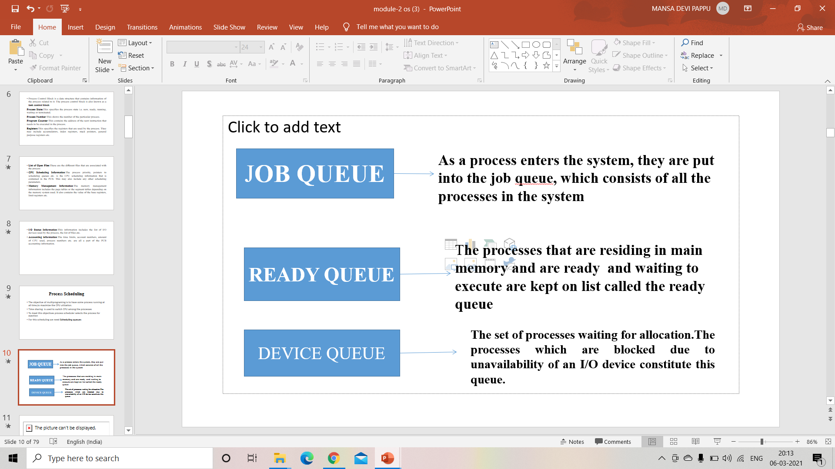
Process Scheduling:
The objective of multiprogramming is to have some process running at all time, to maximize the CPU utilization.
Time sharing is used to switch CPU among the processes
To meet this objectives process scheduler selects the process for execution
For this scheduling we need Scheduling queues.
Scheduling Queues

Slide 12
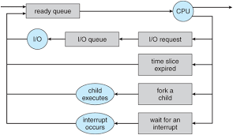
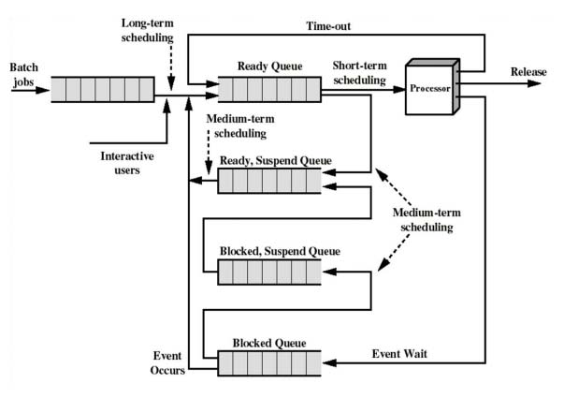
Queuing Diagram Representation of Process Scheduling

Slide 13
Long Term Scheduler:
Long Term Scheduler run less frequently. Long Term Scheduler or Job Scheduler. It selects processes from job pool and loads them into the memory for execution.
2 cases:
I/O Bound Process – The amount of Time of process which is utilize the I/O devices.- ( waiting state)
CPU Bound Process- The amount of Time of Process which is spends in the execution Time – CPU or Processor.
Note: It is important that the long term scheduler select a good process mix of I/O Bound and CPU Bound Process

Slide 14
Note:
If all processes are I/O Bound, the Ready queue will almost always be empty.
If all processes are CPU Bound, the I/O waiting queue will almost always be empty, devices go unused and again the system will be unbalanced.
Short Term Scheduler(or) CPU Scheduler:
It Runs Frequently and it increase the CPU Performance and Execution Rate.
It used for selects from among the processes that are ready to execute and allocates the CPU to one of them.

Slide 15
Medium Term Scheduler:
This scheduler removes the processes from memory and thus reduces the degree of multiprogramming. At some other time, the process can be reintroduced into memory and its execution can be continued where it left off. This scheme is called swapping.

Slide 16
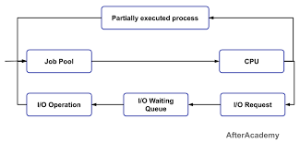
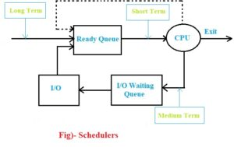

Slide 17
SR. NO. | SHORT TERM SCHEDULER | MEDIUM TERM SCHEDULER | LONG TERM SCHEDULER
1. | It is a CPU scheduler. | It is a process swapping scheduler. | It is a job scheduler.
2. | Speed is fastest than other two. | Speed is in between both short and long term scheduler. | Speed is lesser than short term scheduler.
3. | It is minimal in time sharing system | It is a part of Time sharing systems.. | It is almost absent or minimal in time sharing system.
4. | It provides lesser control over degree of multi-programming. | It reduces the degree of multi-programming. | It controls the degree of multi-programming.
5. | It selects those processes which are ready to execute. | It can re-introduce the process into memory and execution can be continued. | It selects processes from pool and loads them into memory for execution.

Slide 18
Context Switch
Switching the CPU to another process requires saving the state of old process and loading the saved state for the new process. This task is known as Context Switch.
The context of a process is represented in the PCB of a process, it includes the value of the CPU Registers, Process State and Memory Management information.
Context switch occurs, the kernel saves the context of the old process in its PCB and loads the saved context of the new process scheduled to run.
Typical Range from 1 to 1000ms

Slide 19
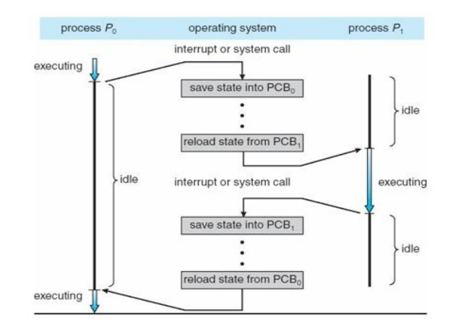

Slide 20
Operations on Processes
Process Creation
Process Termination
The Processes created and deleted dynamically. The systems must provide a mechanism for process creation and termination. In 2 cases –WINDOWS and LINUX/UNIX systems.

Slide 21
Process Creation:duplicate of the regular process
A process may create many several new processes via create process system call.
During the execution of the process
The creating process is called Parent process.
The new process created are called Child process of that process
Each of this new processes may also create other processes ,which are forming a tree.

Slide 22
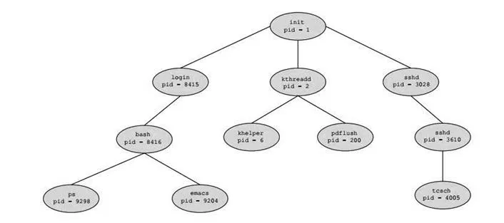
How to create a process for existing Process??
In Unix Environment – fork()- system call
In Windows Environment – We can create a process by using create process() system call.
Eg: - main()
{
fork( )
printf(“GITAM UNIVERSITY %d’, get pid);
}
Output:- P1 GITAM UNIVERSITY 4482 (Parent Process)
P2 GITAM UNIVERSITY 4474 (Child Process)
}

Slide 23
Process Termination:
When a process is terminated the resources are being used by the process are released by the OS.
Exit() –system call will be activate
If parent process is terminated then the child process also be deleted.
Abort()
A Process terminates when it finishes the last statement and it asks the OS to delete it by using the exit() system call.
When the process terminates the resources which are used by the process are deallocated by the OS.
When the child process terminates it has to send the status to the parent with the wait() system call.
The child process can also terminated by the parent.

Slide 24
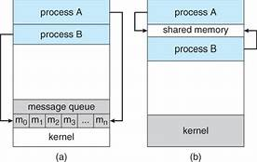
Inter Process Communication(IPC)
It is a mechanism that OS provides to allow the processes to manage shared data.
It describes how the process can communicate with each other.(IPC)
2 cases –
Independent Process
Cooperating Process
Note: Several Reasons for providing an environment that allows process cooperation.
Information sharing
Computation speed up
Modularity
Convenience
Comparing to Independent Process, the cooperating Process requires an IPC Mechanism, that will allow them to exchange data and information.
2 Fundamental Models of IPC:
Shared Memory
Message Passing

Slide 25
Inter Process Communication(IPC)
The way the process communicating with each other s known as Inter Process Communication(IPC).
Process executing concurrently in the OS may be either independent process or cooperating process
INDEPENDENT PROCESS: An independent process is not affected by the execution of other processes
CO-OPERATING PROCESS: co-operating process can be affected by other executing processes

Slide 26
Any process that share the data with other process is a cooperating process.
IPC is required only in Cooperating process
REASONS FOR PROVIDING AN ENVIRONMENT FOR PROCESS COOPERATION
1.INFORMATION SHARING: Users may be interested in same piece of information.so that info can be shared. This may include access to the same files. A mechanism is required so that the processes can access the files concurrently.
2.COMPUTATTION SPEED: Main task is divide into sub tasks. Subtasks of a single task can be performed parallelly using cooperating processes. This increases the computation speedup as the task can be executed faster. However, this is only possible if the system has multiple processing elements.
3.MODULARITY:Modularity involves dividing complicated tasks into smaller modules. These modules can completed by different cooperating processes. This leads to faster and more efficient completion of the required modules.
4.CONVINENCE:There are many tasks that a user needs to do such as compiling, printing, editing etc. It is convenient if these tasks can be managed by cooperating processes.

Slide 27
Two fundamental models for inter process communication
Shared Memory
Message passing
In shared memory model, region of memory that is shared by cooperating process is established.
Processes can exchange information by reading and writing data to the shared region
In Message Passing model, communication can takes place by means of messages exchanged between the processes

Slide 28
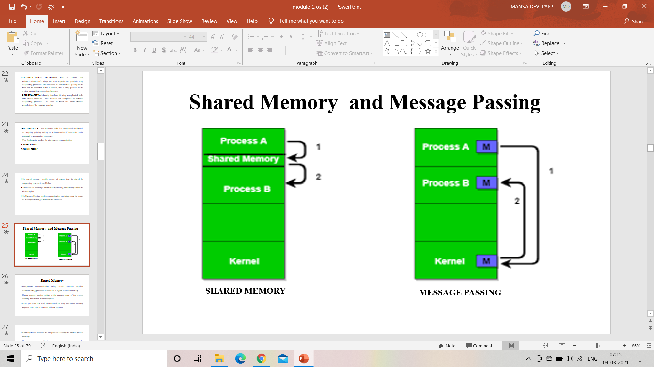

Slide 29
Shared Memory
Interprocess communication using shared memory requires communicating processes to establish a region of shared memory
Shared memory region resides in the address space of the process creating the shared memory segment.
Other processes that wish to communicate using the shared memory segment must attach it to their address segment.
Normally the os prevents the one process accessng the another process memory
Shared memory require that two or more process agrees to remove the restrictions.
eg for shared memory-Producer Consumer Problem

Slide 30
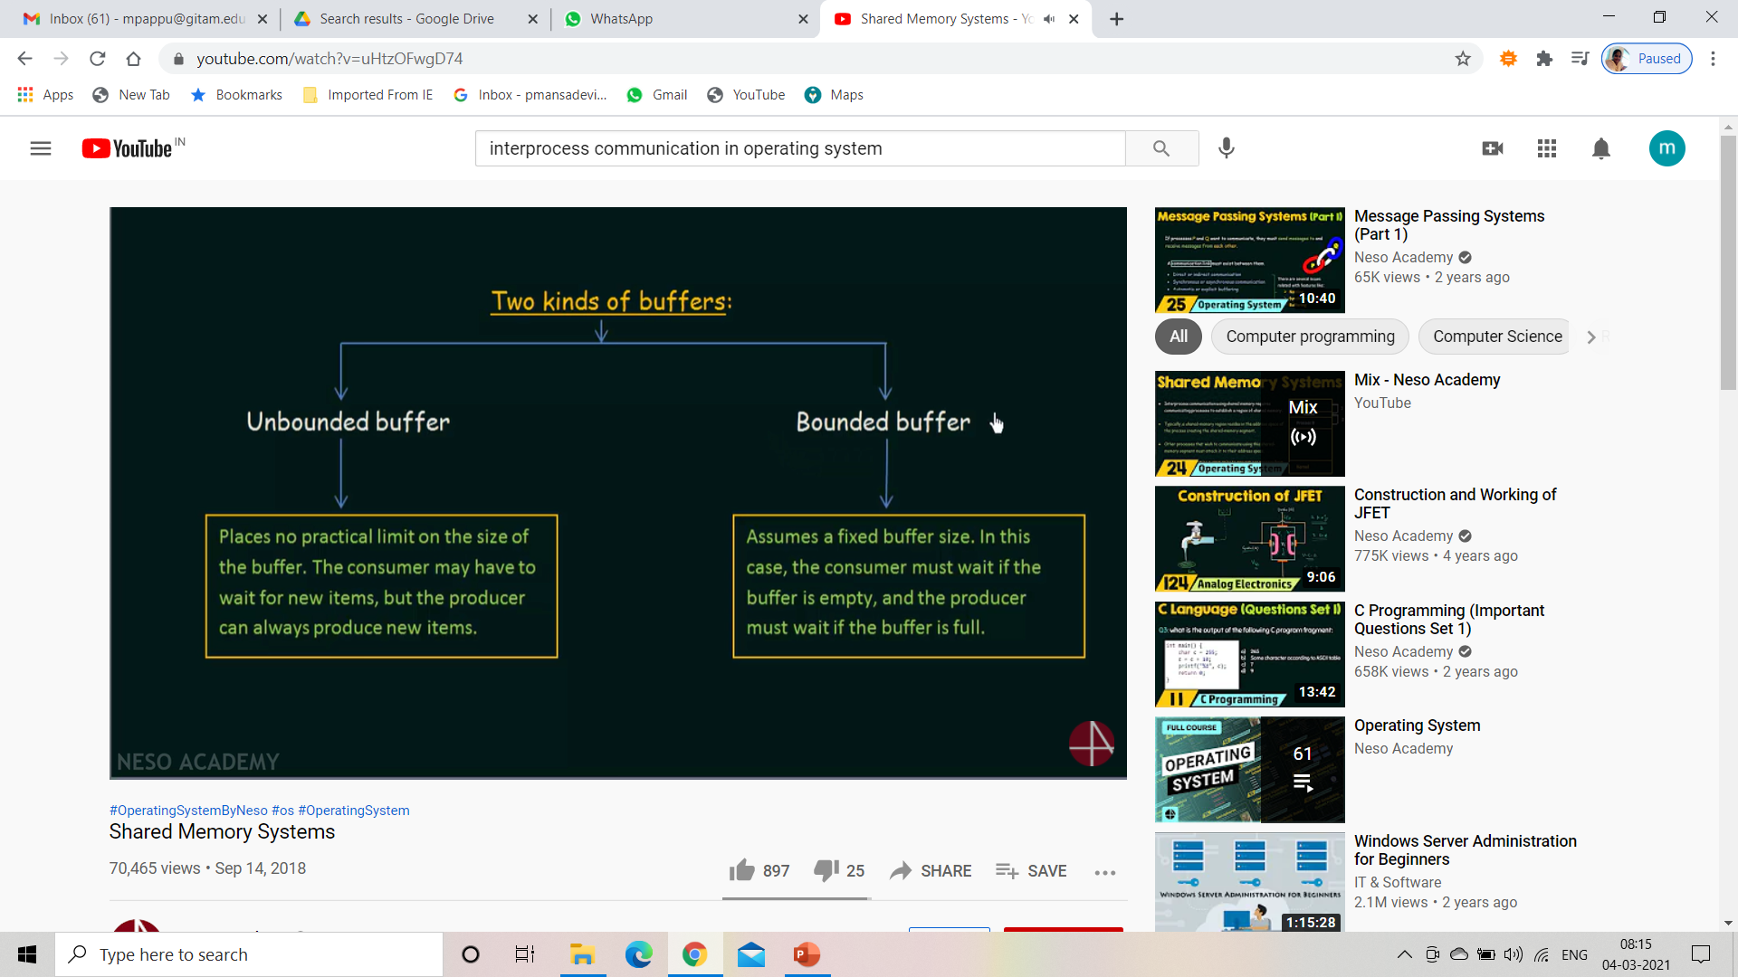
Two Kinds of Buffer

Slide 31
Message Passing
In this method, processes communicate with each other without using any kind of shared memory.
This is useful in the distributed environment, where the communication resides in different computers connected by the network.
Not sharing address space
Facilities provided by message passing
send(message)
receive(message)
Message passing can be done in 3 ways
Naming
Synchronization
Buffering
1) Naming: Process want to communicate with each other they use naming
They can be direct or indirect.
Direct communication: Each process want to communicate must explicitly name the recipient or sender of communication
send(P,message)-Send message to process P
receive(Q,message)-Receive mesage from process Q

Slide 32
InDirect Communications: The messages are sent and received from mailboxes or ports
2) Synchronization: exchanging messages using basic primitives.
We need at least two primitives:
– send(message, destination) or send(message)
– receive(message, host) or receive(message)
Message passing either be blocking or unblocking also known as synchronous or asynchronous
Blocking send: The sending process is blocked until the message is received by the receiver.
Blocking Receiver: The Receiver blocks until the message is available
Non blocking send: The sending process sends the messages and continue its operation
Non Blocking Receiver: The Receiver is not blocked
3) Buffering: When communication is direct or indirect, messages exchanged by communicating processes is residing in the temporary queue.

Slide 33
These queues are implemented in 3 ways
1.Zero capacity: The queue has a max length of zero, thus the link cannot have messages waiting in it. In this case the sender must block until the recipient receives the message.
One message can be send at a time
2.Bounded capacity: In this the queue has finite length n, thus atmost n messages can reside in it. If the queue is not full when a new message is sent, the message is placed in the queue and the sender can continue the execution without waiting. The link capacity is finite, however if the kink is full the sender must block until space is available in the queue.
Unbounded Buffer: The queue length is potentially infinite, thus any number of messages can wait in it. The sender never blocks.

Slide 34
CPU Scheduler:
It used for selects from among the processes that are ready to execute and allocates the CPU to one of them.
Whenever the CPU becomes idle, the OS must select one of the processes in the ready queue to be executed. The selection process is carried out by the short term scheduler.
Scheduler Vs Dispatcher
When the processes are in the ready state, then the CPU applies some process scheduling algorithm and choose one process from a list of processes that will be executed at a particular instant of time. This is done by a scheduler i.e. selecting one process from a number of processes is done by a scheduler.
Now, the selected process has to be transferred from the current state to the desired or scheduled state. So, it is the duty of the dispatcher to dispatch or transfer a process from one state to another. A dispatcher is responsible for context switching and switching to user mode.

